Slide 1
20
Job Order Costing
Learning Objectives
1
Describe cost systems and the flow of costs in a job order system.
2
Use a job cost sheet to assign costs to work in process.
3
Demonstrate how to determine and use the predetermined overhead rate.
4
Prepare entries for manufacturing and service jobs completed and sold.
5
Distinguish between under- and overapplied manufacturing overhead.

Slide 2
LEARNING
OBJECTIVE
Describe cost systems and the flow of
costs in a job order system.
1
Cost Accounting involves
Measuring,
Recording, and
Reporting product costs.
  Accounts are fully integrated into the general ledger.
  Perpetual inventory system provides immediate, up-to-date information on the cost of a product.
  Two basic types: (1) a process order cost system and (2) a job order cost system.
LO 1

Slide 3
Process Cost System
  Used when a large volume of similar products are manufactured - (cereal, refining of petroleum, production of ice cream).
  Costs are accumulated for a time period – (week or month).
  Costs are assigned to departments or processes for a specified period of time.
LO 1

Slide 4
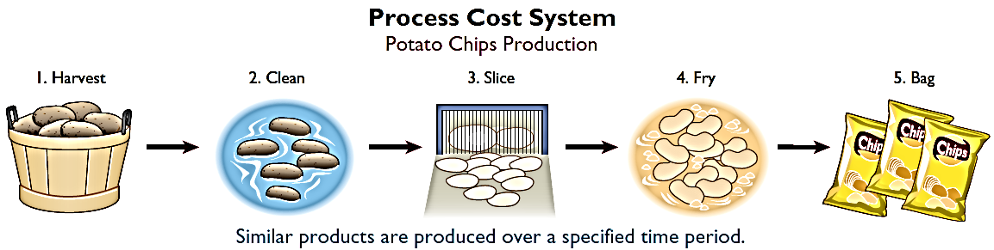
Process Cost System
Illustration 20-1
Process cost system
LO 1

Slide 5
Job Order Cost System
  Costs are assigned to each job or batch.
  Important feature: Each job or batch has its own distinguishing characteristics.
  Objective is to compute the cost per job.
  Measures costs for each job completed – not for set time periods.
LO 1

Slide 6
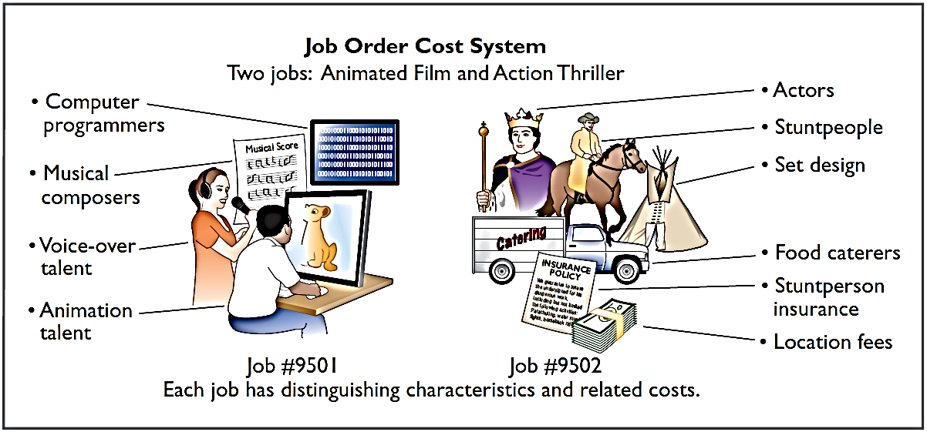
Job Order Cost System
  Illustration 20-2 shows the recording of costs in a job order cost system for Disney as it produced two different films.
Illustration 20-2
Job order cost system for Disney
LO 1

Slide 7
Management Insight
Jobs Won, Money Lost
Many companies suffer from poor cost accounting. As result, they sometimes make products they should not be selling at all, or they buy product components that they could more profitably make themselves. Also, inaccurate cost data leads companies to misallocate capital and frustrates efforts by plant managers to improve efficiency. For example, consider the case of a diversified company in the business of rebuilding diesel locomotives. The managers thought they were making money, but a consulting firm found that the company had seriously underestimated costs. The company bailed out of the business and not a moment too soon. Says the consultant who advised the company, “The more contracts it won, the more money it lost.” Given that situation, a company cannot stay in business very long!
LO 1

Slide 8
Job Order Cost Flow
The flow of costs parallels the physical flow of the materials as they are converted into finished goods
  Manufacturing costs are assigned to the Work in Process (WIP) Inventory account.
  Cost of completed jobs is transferred to the Finished Goods Inventory account.
  When units are sold, the cost is transferred to the Cost of Goods Sold account.
LO 1

Slide 9
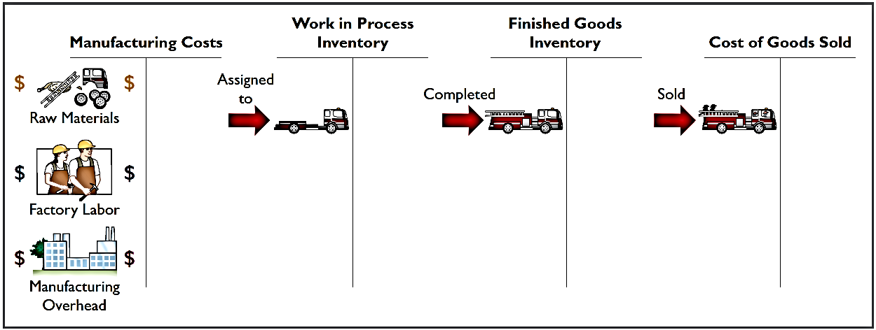
Job Order Cost Flow
Illustration 20-3
Flow of costs in job order costing
Basic overview of the flow of costs in a manufacturing setting for production of a fire truck.
LO 1

Slide 10
Accumulating Manufacturing Costs
RAW MATERIAL COSTS
Illustration: Wallace Company purchases 2,000 lithium batteries (Stock No. AA2746) at $5 per unit ($10,000) and 800 electronic modules (Stock No. AA2850) at $40 per unit ($32,000) for a total cost of $42,000 ($10,000 + $32,000). The entry to record this purchase on January 4 is:
Jan. 4 Raw Materials Inventory 42,000
Accounts Payable 42,000
LO 1

Slide 11
Accumulating Manufacturing Costs
FACTORY LABOR COSTS
Consists of three costs:
  Gross earnings of factory workers,
  Employer payroll taxes on these earnings, and
  Fringe benefits (such as sick pay, pensions, and vacation pay) incurred by the employer.
LO 1

Slide 12
Accumulating Manufacturing Costs
FACTORY LABOR COSTS
Illustration: Wallace incurs $32,000 of factory labor costs. Of that amount, $27,000 relates to wages payable and $5,000 relates to payroll taxes payable in February. The entry to record factory labor for the month is:
Jan. 31 Factory Labor 32,000
Factory Wages Payable 27,000
Employer Payroll Taxes Payable 5,000
LO 1

Slide 13
Accumulating Manufacturing Costs
MANUFACTURING OVERHEAD COSTS
  Many types of overhead costs
    For example, property taxes, depreciation, insurance, and repairs related to the manufacturing process.
  Costs unrelated to manufacturing process are expensed.
  Costs related to manufacturing process are accumulated in Manufacturing Overhead account.
    Manufacturing overhead subsequently assigned to work in process.
LO 1

Slide 14
Accumulating Manufacturing Costs
MANUFACTURING OVERHEAD COSTS
Illustration: Using assumed data, the summary entry for manufacturing overhead in Wallace Manufacturing Company is:
Jan. 31 Manufacturing Overhead 13,800
Utilities Payable 4,800
Prepaid Insurance 2,000
Accounts Payable (for repairs) 2,600
Accumulated Depreciation 3,000
Property Taxes Payable 1,400
LO 1

Slide 15
DO IT!
Accumulating Manufacturing Costs
1
During the current month, KRT Company incurs the following manufacturing costs:
(a) Raw material purchases of $4,200 on account.
Factory labor of $18,000. Of that amount, $15,000 relates to wages payable and $3,000 relates to payroll taxes payable.
Factory utilities of $2,200 are payable, prepaid factory insurance of $1,800 has expired, and depreciation on the factory building is $3,500.
Prepare journal entries for each type of manufacturing cost.
LO 1

Slide 16
DO IT!
Accumulating Manufacturing Costs
1
Prepare journal entries for each type of manufacturing cost.
(a) Raw material purchases of $4,200 on account.
Raw Materials Inventory 4,200
Accounts Payable 4,200
(b) Factory labor of $18,000. Of that amount, $15,000 relates to wages payable and $3,000 relates to payroll taxes payable.
Factory Labor 18,000
Factory Wages Payable 15,000
Employer Payroll Taxes Payable 3,000
LO 1

Slide 17
DO IT!
Accumulating Manufacturing Costs
1
Prepare journal entries for each type of manufacturing cost.
(c) Factory utilities of $2,200 are payable, prepaid factory insurance of $1,800 has expired, and depreciation on the factory building is $3,500.
Manufacturing Overhead 7,500
Utilities Payable 2,200
Prepaid Insurance 1,800
Accumulated Depreciation 3,500
LO 1

Slide 18
LEARNING
OBJECTIVE
Use a job cost sheet to assign costs to work in process.
2
Assigning manufacturing costs to work in process results in the following entries.
Debits made to Work in Process Inventory
Credits made to
  Raw Materials Inventory
  Factory Labor
  Manufacturing Overhead
LO 2

Slide 19
Job Cost Sheet
  Used to record costs chargeable to specific jobs.
  Constitutes the subsidiary ledger for the work in process account.
  Each entry to Work in Process Inventory must be accompanied by a corresponding posting to
  one or more job cost sheets.
LO 2

Slide 20
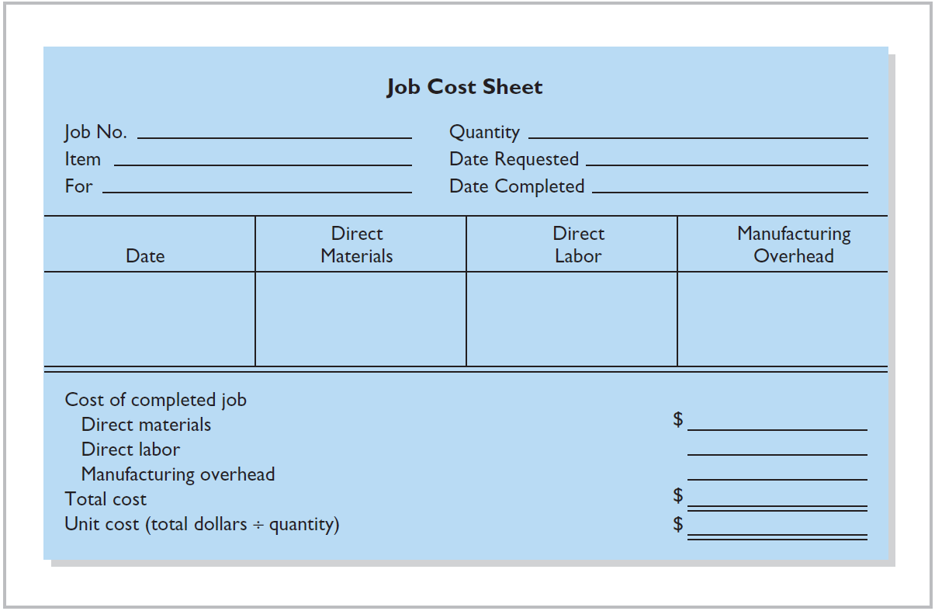
Illustration 20-4
Job cost sheet
LO 2

Slide 21
Raw Material Costs
  Assigned to a job when materials are issued in response to requests.
  Materials requisition slip
    Written authorization for issuing raw materials.
    May be directly issued to use on a job - direct materials (charged to Work in Process Inventory).
    May be considered indirect materials – charged to Manufacturing Overhead.
LO 2

Slide 22
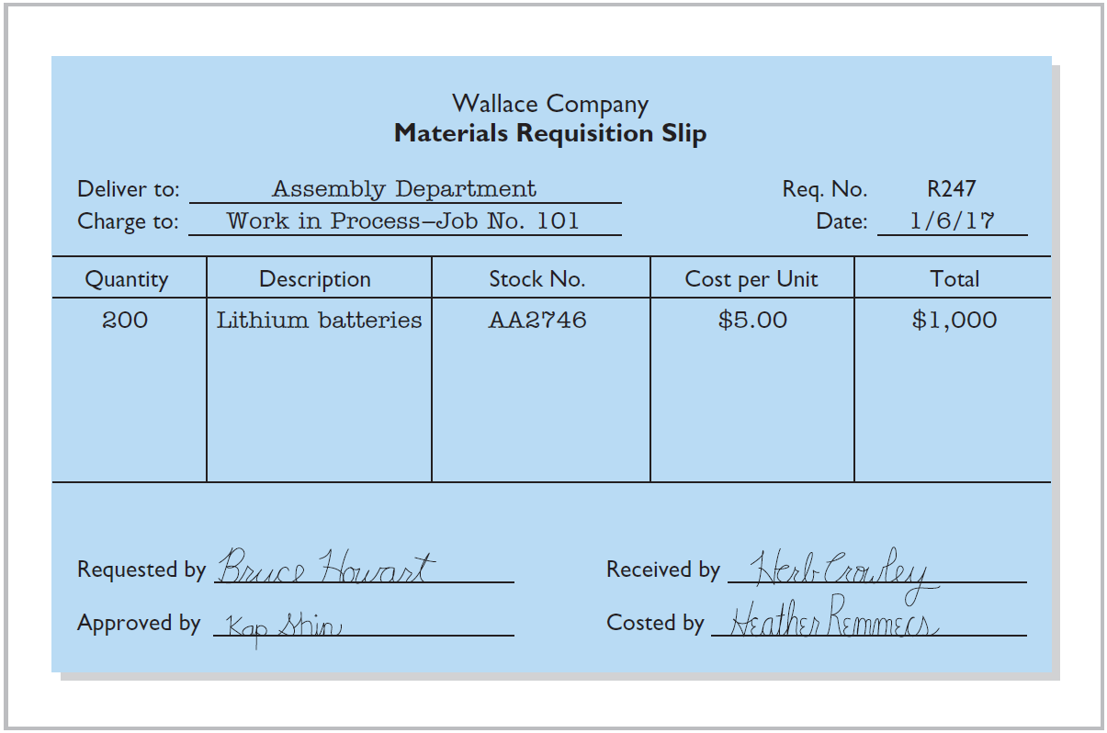
Illustration 20-5
Materials requisition slip
LO 2

Slide 23
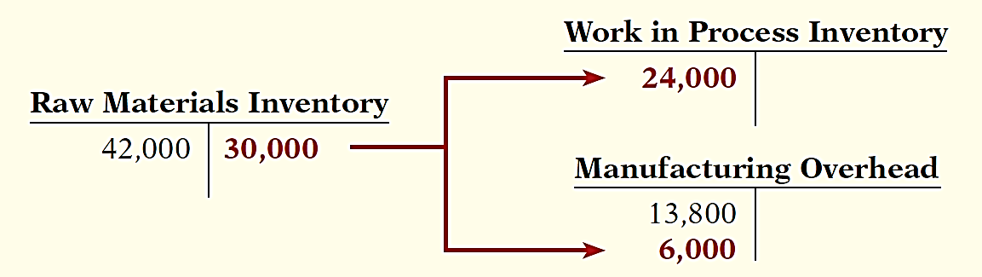
Raw Material Costs
Illustration: Wallace uses $24,000 of direct materials and $6,000 of indirect materials in January, the entry is:
Jan. 31 Work in Process Inventory 24,000
Manufacturing Overhead 6,000
Raw Materials Inventory 30,000
LO 2

Slide 24
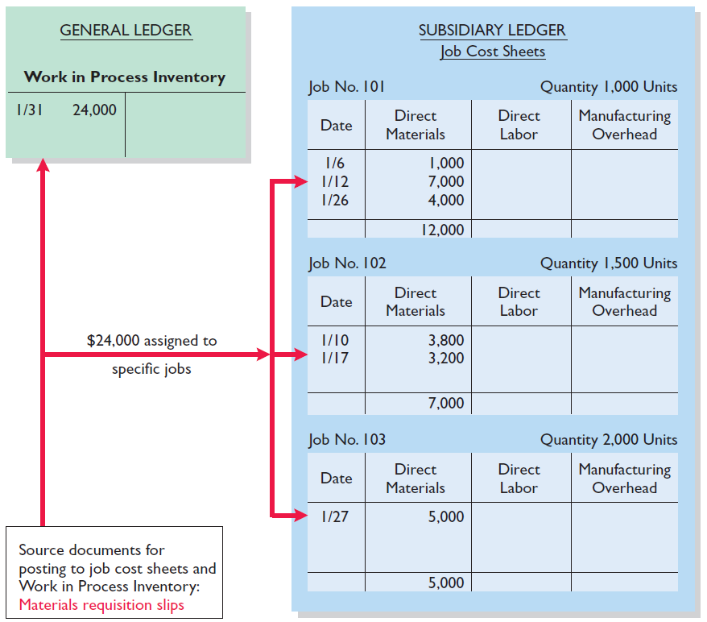
Raw Material Costs
Illustration 15-6
The sum of the direct materials columns of the job cost sheets should equal the direct materials debited to Work in Process Inventory account.
Illustration 20-6
Job cost sheets–posting of direct materials
LO 2

Slide 25
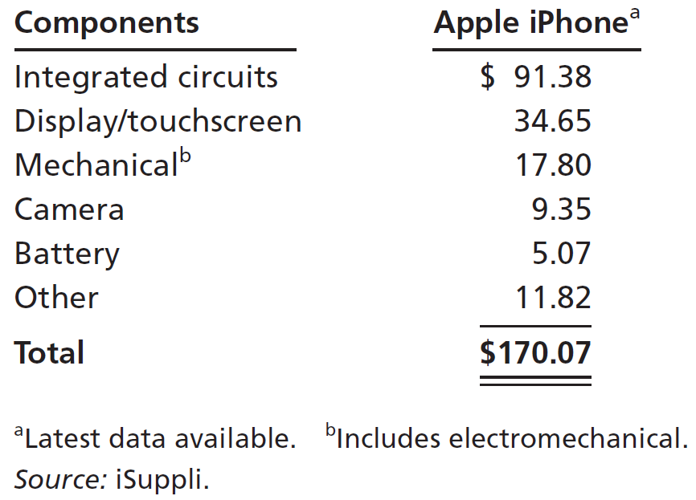
Management Insight
iSuppli
The Cost of an iPhone? Just Tear One Apart
Many All companies need to know what it costs to make their own products—but a lot of companies would also like to know the cost of their competitors’ products as well. That’s where iSuppli steps in. For a price, iSuppli will tear apart sophisticated electronic devices to tell you what it would cost to replicate. In the case of smartphones, which often have more than 1,000 tiny components, that is no small feat. As shown in the chart to the right, the components of a recent iPhone model cost about $170. Assembly adds only about another $6.50. However, the difference between what you pay (about double the total component cost) and the “cost” is not
all profit. You also have to consider the additional nonproduction costs of research, design, marketing, patent fees, and selling costs.
Source: “The Business of Dissecting Electronics: The Lowdown on Teardowns,” The Economist.com (January 21, 2010).
LO 2

Slide 26
Factory Labor Costs
  Assigned to jobs on the basis of time tickets.
  Time tickets are prepared when the work is performed.
  Time tickets indicate:
    Employee
    Hours worked
    Account and job charged
    Total labor cost
LO 2

Slide 27
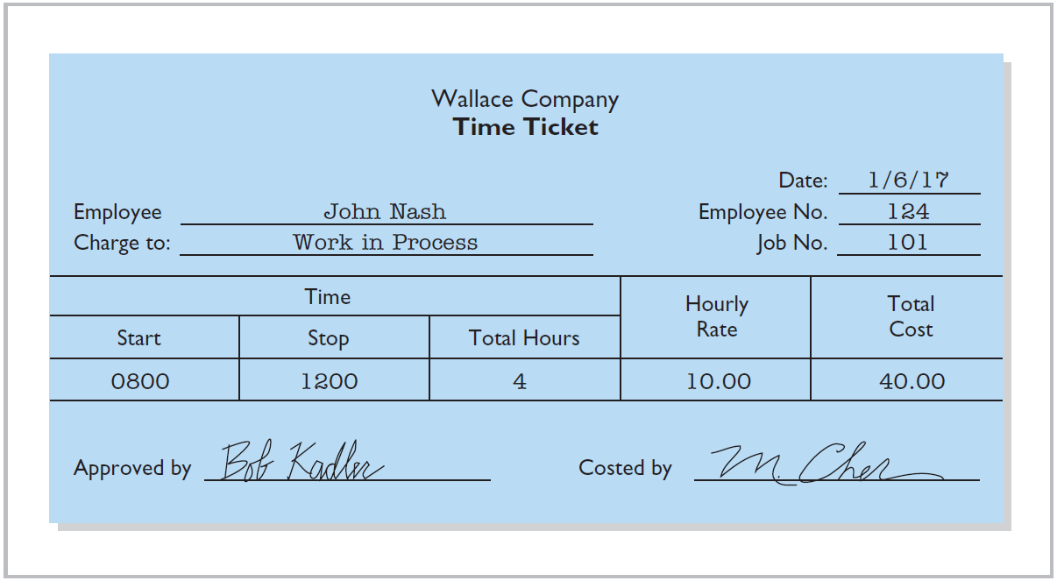
Factory Labor Costs
Illustration 20-7
Time ticket
LO 2

Slide 28
Factory Labor Costs
Illustration: The time tickets are later sent to the payroll department, which applies the employee’s hourly wage rate and computes the total labor cost. If the $32,000 total factory labor cost consists of $28,000 of direct labor and $4,000 of indirect labor, the entry is:
Jan. 31 Work in Process Inventory 28,000
Manufacturing Overhead 4,000
Factory Labor 32,000
LO 2

Slide 29
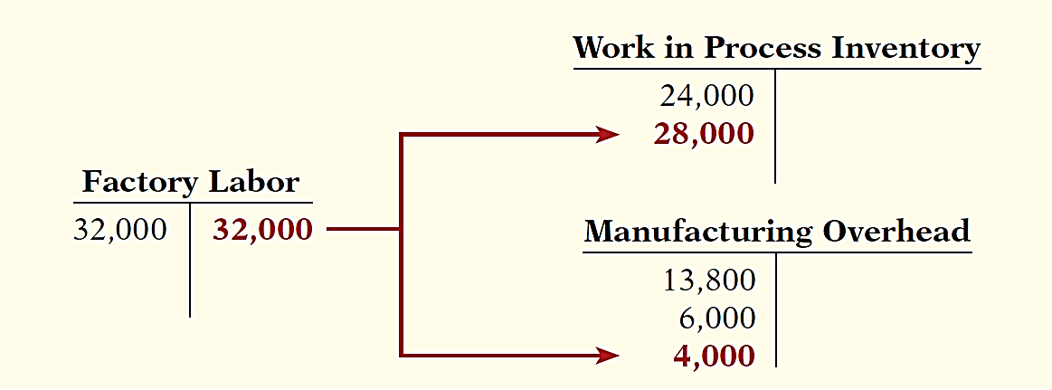
Factory Labor Costs
Jan. 31 Work in Process Inventory 28,000
Manufacturing Overhead 4,000
Factory Labor 32,000
LO 2

Slide 30
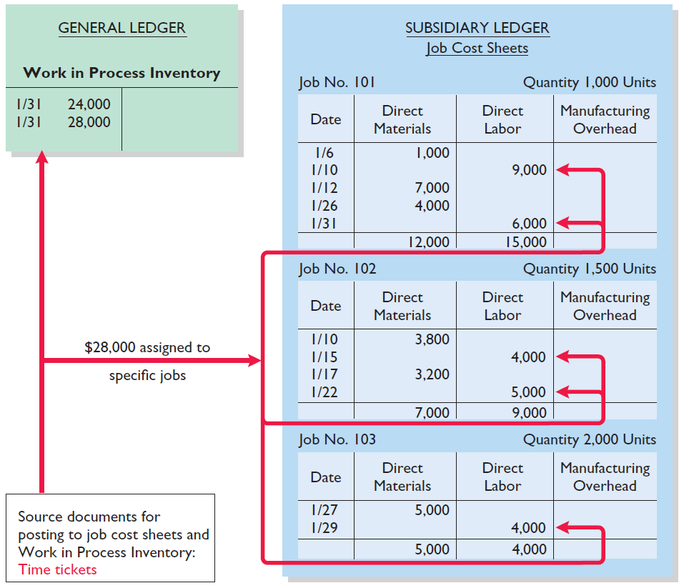
Factory Labor Costs
The sum of the direct labor columns of the job cost sheets should equal the direct labor debited to Work in Process Inventory.
Illustration 20-8
Job cost sheets–direct labor
LO 2

Slide 31
DO IT!
2
Work in Process
Danielle Company is working on two job orders. The job cost sheets show the following:
Direct materials—Job 120 $6,000; Job 121 $3,600
Direct labor—Job 120 $4,000; Job 121 $2,000
Manufacturing overhead—Job 120 $5,000; Job 121 $2,500
Prepare the three summary entries to record the assignment of costs to Work in Process from the data on the job cost sheets.
LO 2

Slide 32
DO IT!
2
Work in Process
Danielle Company is working on two job orders. The job cost sheets show the following:
Direct materials—Job 120 $6,000; Job 121 $3,600
Direct labor—Job 120 $4,000; Job 121 $2,000
Manufacturing overhead—Job 120 $5,000; Job 121 $2,500
Prepare the three summary entries to record the assignment of costs to Work in Process from the data on the job cost sheets.
Work in Process Inventory 9,600
Raw Materials Inventory 9,600
LO 2

Slide 33
DO IT!
2
Work in Process
Danielle Company is working on two job orders. The job cost sheets show the following:
Direct materials—Job 120 $6,000; Job 121 $3,600
Direct labor—Job 120 $4,000; Job 121 $2,000
Manufacturing overhead—Job 120 $5,000; Job 121 $2,500
Prepare the three summary entries to record the assignment of costs to Work in Process from the data on the job cost sheets.
Work in Process Inventory 6,000
Factory Labor 6,000
LO 2

Slide 34
DO IT!
2
Work in Process
Danielle Company is working on two job orders. The job cost sheets show the following:
Direct materials—Job 120 $6,000; Job 121 $3,600
Direct labor—Job 120 $4,000; Job 121 $2,000
Manufacturing overhead—Job 120 $5,000; Job 121 $2,500
Prepare the three summary entries to record the assignment of costs to Work in Process from the data on the job cost sheets.
Work in Process Inventory 7,500
Manufacturing Overhead 7,500
LO 2

Slide 35
LEARNING
OBJECTIVE
Demonstrate how to determine and use the predetermined overhead rate.
3
Manufacturing Overhead Costs
  Relates to production operations as a whole.
  Cannot be assigned to specific jobs based on actual costs incurred.
  Companies assign to work in process and to specific jobs on an estimated basis through the use of a …
Predetermined Overhead Rate
LO 3

Slide 36
Predetermined Overhead Rate
  Based on the relationship between estimated annual overhead costs and expected annual operating activity.
  Expressed in terms of an activity base such as:
    Direct labor costs
    Direct labor hours
    Machine hours
    Any other measure that will provide an equitable basis for applying overhead costs to jobs.
LO 3

Slide 37
Predetermined Overhead Rate
  Established at the beginning of the year.
  Small companies often use a single, company-wide predetermined rate.
  Large companies often use a different rate for each department and each department may have a different activity base.
  Formula for computing the predetermined rate overhead rate is:
Illustration 20-9
LO 3

Slide 38
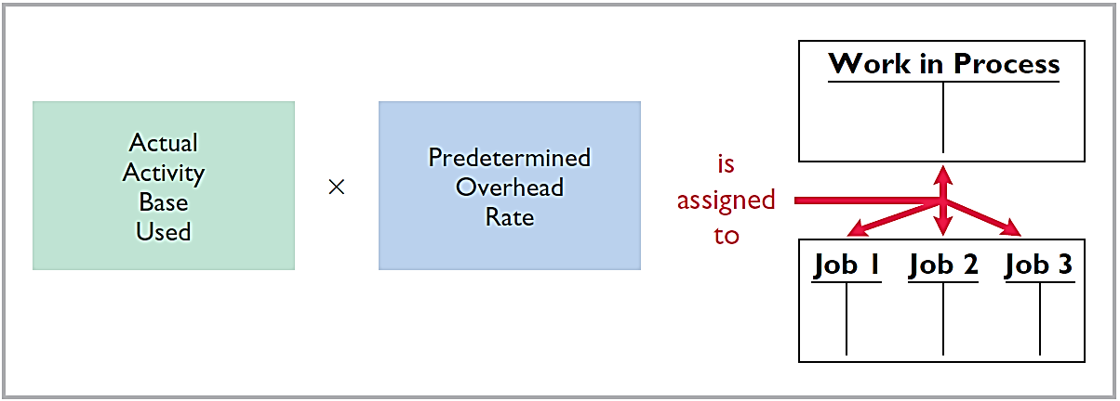
Predetermined Overhead Rate
Manufacturing overhead costs are assigned to Work in Process during the period to get timely information about the cost of a completed job.
Illustration 20-10
Using predetermined overhead rates
LO 3

Slide 39
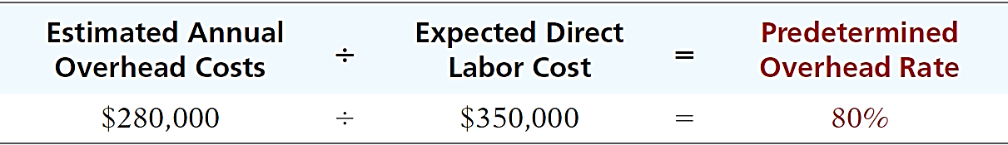
Predetermined Overhead Rate
Illustration: Wallace Company uses direct labor cost as the activity base. Assuming that the company expects annual overhead costs to be $280,000 and direct labor costs for the year to be $350,000, compute the overhead rate.
Illustration 20-11
Calculation of predetermined
overhead rate
This means that for every dollar of direct labor, Wallace will assign _________ of manufacturing overhead to a job.
80 cents
LO 3

Slide 40
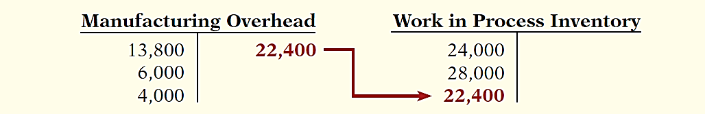
Predetermined Overhead Rate
Illustration: Wallace applies manufacturing overhead to work in process when it assigns direct labor costs. Calculate the amount of applied overhead assuming direct labor costs were $28,000.
$28,000 x 80% = $22,400
The following entry records this application.
Jan. 31 Work in Process Inventory 22,400
Manufacturing Overhead 22,400
LO 3

Slide 41
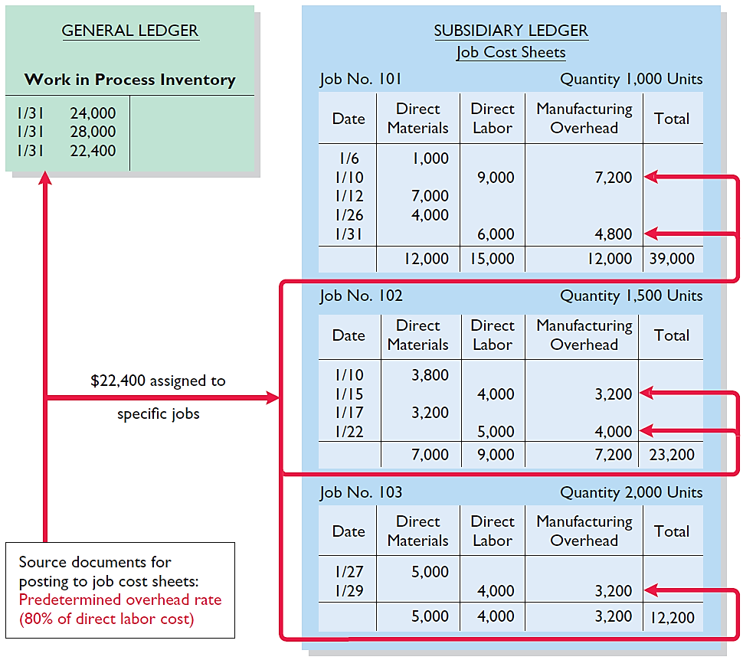
Predetermined Overhead Rate
The sum of the manufacturing overhead columns of the job cost sheets should equal the manufacturing overhead debited (i.e., applied) to Work in Process Inventory.
Illustration 20-12
Job cost sheets–manufacturing
overhead applied

Slide 42
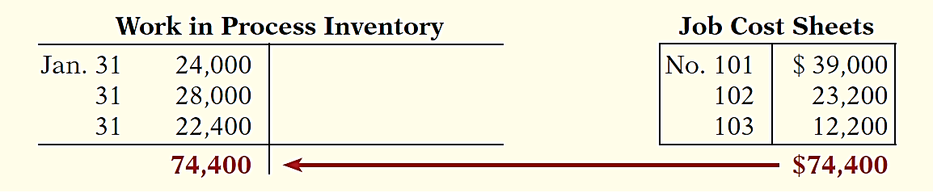
Predetermined Overhead Rate
At the End of Each Month:
The balance in the Work in Process Inventory should equal the sum of the costs shown on the job cost sheets of unfinished jobs.
Illustration 20-13
Proof of job cost sheets to
work in process inventory
LO 3

Slide 43
DO IT!
3
Predetermined Overhead Rate
Stanley Company produces specialized safety devices. For the year, manufacturing overhead costs are expected to be $160,000. Expected machine usage is 40,000 hours. The company assigns overhead based on machine hours. Job No. 302 used 2,000 machine hours. Compute the predetermined overhead rate.
Solution
$160,000 ÷ 40,000 hours = $4.00 per machine hour
LO 3

Slide 44
DO IT!
3
Predetermined Overhead Rate
Stanley Company produces specialized safety devices. For the year, manufacturing overhead costs are expected to be $160,000. Expected machine usage is 40,000 hours. The company assigns overhead based on machine hours. Job No. 302 used 2,000 machine hours. Determine the amount of overhead to allocate to Job No. 302.
Solution
2,000 hours x $4.00 = $8,000
LO 3

Slide 45
DO IT!
3
Predetermined Overhead Rate
Stanley Company produces specialized safety devices. For the year, manufacturing overhead costs are expected to be $160,000. Expected machine usage is 40,000 hours. The company assigns overhead based on machine hours. Job No. 302 used 2,000 machine hours. Prepare the entry to assign overhead to Job No. 302 on March 31.
Solution
Work in Process Inventory 8,000
Manufacturing Overhead 8,000
LO 3

Slide 46
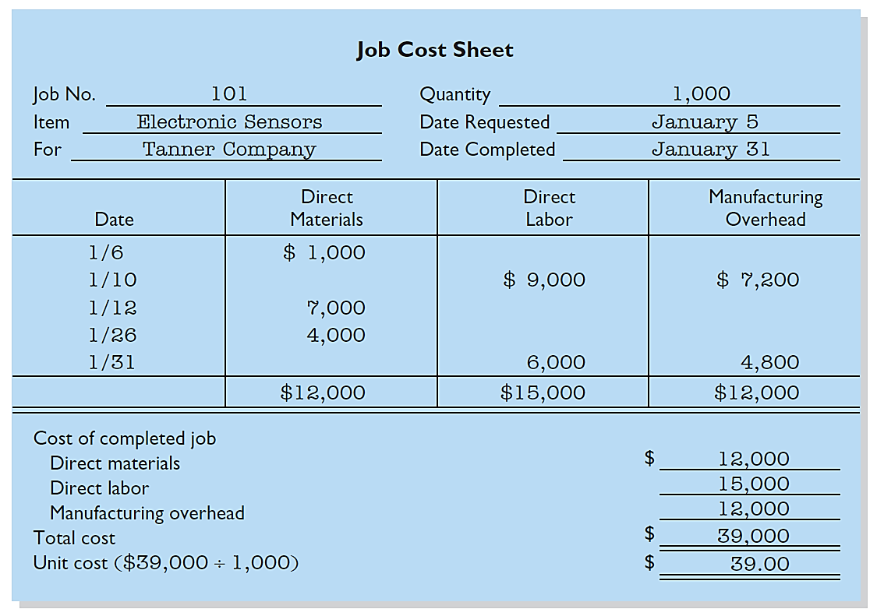
LEARNING
OBJECTIVE
Prepare entries for manufacturing and service jobs completed and sold.
4
Assigning Costs to Finished Goods
When a job is completed, Wallace Company summarizes the costs and completes the lower portion of the applicable job cost sheet.
Illustration 20-14
Completed job cost sheet

Slide 47
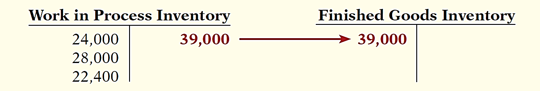
Assigning Costs to Finished Goods
Illustration: When a job is completed, Wallace makes an entry to transfer its total cost to finished goods inventory.
Jan. 31 Finished Goods Inventory 39,000
Work in Process Inventory 39,000
LO 4

Slide 48
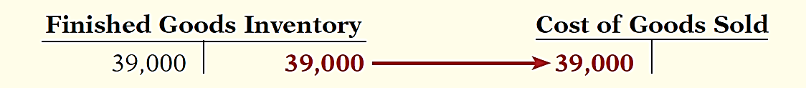
Assigning Costs to Cost of Goods Sold
Illustration: On January 31 Wallace Manufacturing sells on account Job 101. The job cost $39,000, and it sold for $50,000. Entries to record the sale and recognize cost of goods sold are:
Jan. 31 Accounts Receivable 50,000
Sales revenue 50,000
Cost of Goods Sold 39,000
Finished Goods Inventory 39,000
LO 4

Slide 49
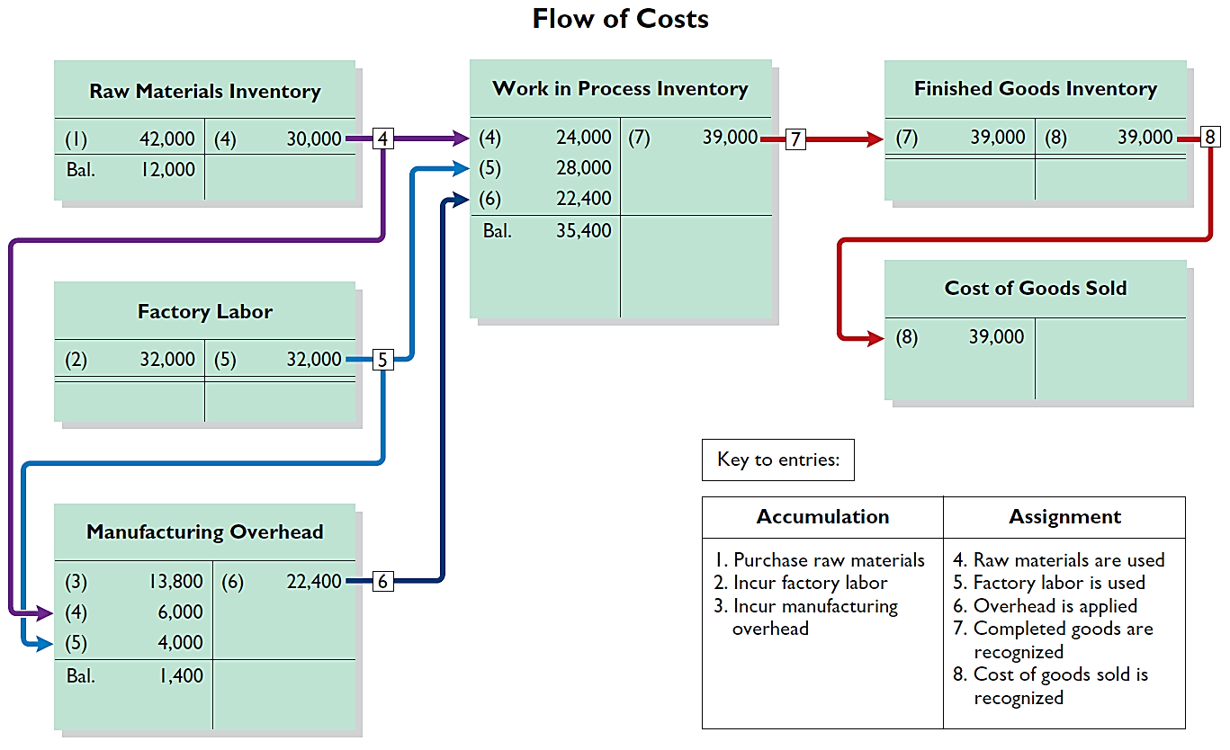
Summary of Job Order Cost Flows
Illustration 20-15
Flow of costs in a job order cost system
LO 4

Slide 50
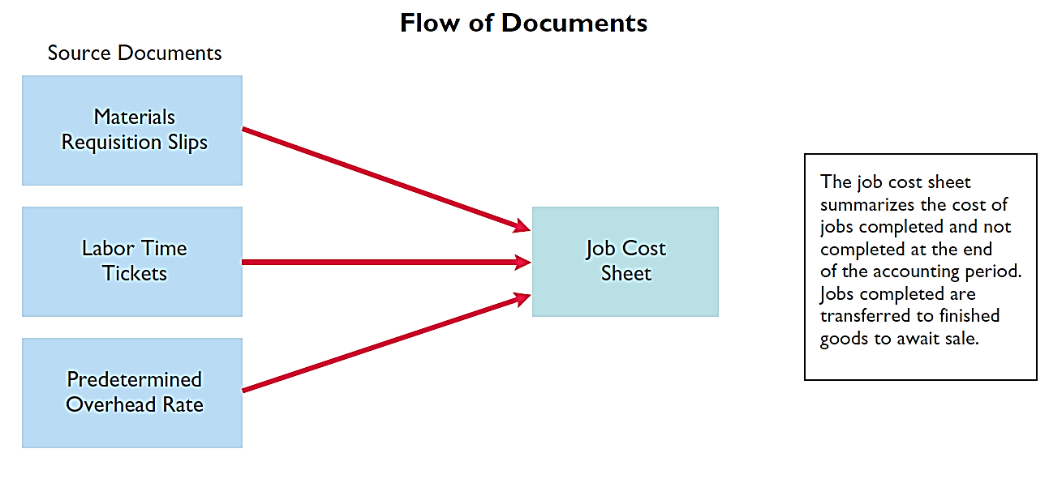
Summary of Job Order Cost Flows
Illustration 20-16
Flow of documents in a job order cost system
LO 4

Slide 51
Job Order Costing for Service Companies
While service companies do not have inventory, the techniques of job order costing are still quite useful in many service-industry environments.
Consider, for example, the Mayo Clinic (health care), PricewaterhouseCoopers (accounting), and Goldman Sachs (investment banking).
These companies need to keep track of the cost of jobs performed for specific customers to evaluate the profitability of medical treatments, audits, or investment banking engagements.
LO 4

Slide 52
Service Company Insight
General Electric
Sales Are Nice, but Service Revenue Pays the Bills
Jet engines are one of the many products made by the industrial operations division of General Electric (GE). At prices as high as $30 million per engine, you can bet that GE does its best to keep track of costs. It might surprise you that GE doesn’t make much profit on the sale of each engine. So why does it bother making them? For the service revenue. During one recent year, about 75% of the division’s revenues came from servicing its own products. One estimate is that the $13 billion in aircraft engines sold during a recent three-year period will generate about $90 billion in service revenue over the 30-year life of the engines. Because of the high product costs, both the engines themselves and the subsequent service are most likely accounted for using job order costing. Accurate service cost records are important because GE needs to generate high profit margins on its service jobs to make up for the low margins on the original sale. It also needs good cost records for its service jobs in order to control its costs. Otherwise, a competitor, such as Pratt and Whitney, might submit lower bids for service contracts and take lucrative service jobs away from GE.
Source: Paul Glader, “GE’s Focus on Services Faces Test,” Wall Street Journal Online (March 3, 2009).
LO 4

Slide 53
Job Order Costing
Advantages
  More precise in assignment of costs to projects than process costing.
  Provides more useful information for determining the profitability of particular projects and for estimating costs when preparing bids on future jobs.
Disadvantage
  Requires a significant amount of data entry.
LO 4

Slide 54
DO IT!
4
Completion and Sale of Jobs
During the current month, Onyx Corporation completed Job 109 and Job 112. Job 109 cost $19,000 and Job 112 costs $27,000. Job 112 was sold on account for $42,000. Journalize the entries for the completion of the two jobs and the sale of Job 112.
Finished Goods Inventory 46,000
Work in Process Inventory 46,000
Accounts Receivable 42,000
Sales Revenue 42,000
Cost of Goods Sold 27,000
Finished Goods Inventory 27,000
LO 4

Slide 55
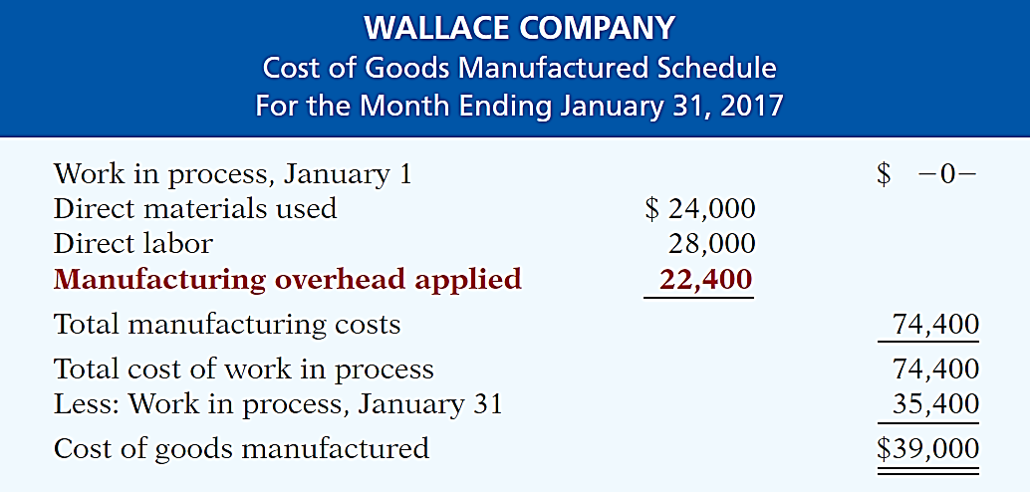
LEARNING
OBJECTIVE
Distinguish between under- and overapplied manufacturing overhead.
5
Illustration 20-17
Cost of goods manufactured
schedule
Shows manufacturing overhead applied rather than actual overhead costs.
Applied overhead is added to direct materials and direct labor to determine total manufacturing costs
LO 5

Slide 56
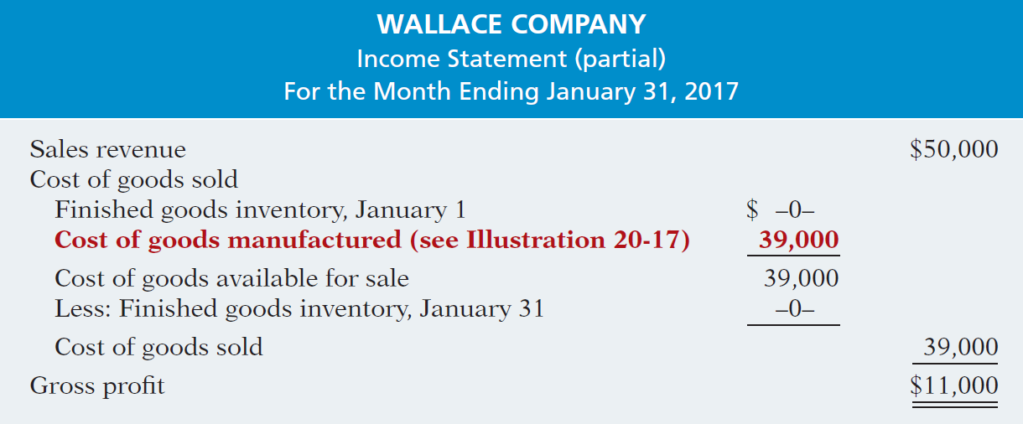
Cost of Goods Manufactured
Partial Income Statement
Illustration 20-18
LO 5

Slide 57
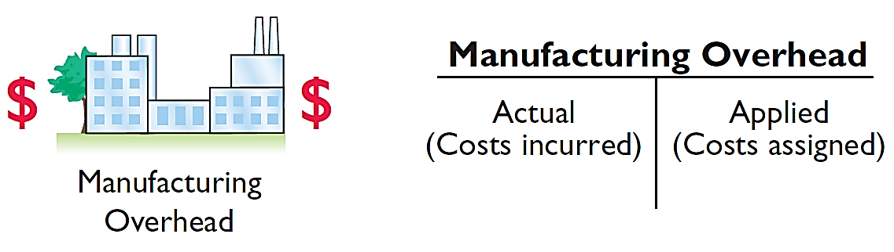
Under- or Overapplied Overhead
  A debit balance in manufacturing overhead means that overhead is underapplied.
  A credit balance in manufacturing overhead means that overhead is overapplied.
Illustration 20-19
Under- and overapplied
overhead
LO 5

Slide 58
Under- or Overapplied Overhead
Any YEAR-END BALANCE in manufacturing overhead is eliminated by adjusting cost of goods sold.
  Underapplied overhead is debited to COGS
  Overapplied overhead is credited to COGS
Illustration: Wallace has a $2,500 credit balance in Manufacturing Overhead at December 31. The adjusting entry for the over-applied overhead is:
Dec. 31 Manufacturing Overhead 2,500
Cost of Good Sold 2,500
LO 5

Slide 59
DO IT!
5
Applied Manufacturing Overhead
For Karr Company, the predetermined overhead rate is 140% of direct labor cost. During the month, Karr incurred $90,000 of factory labor costs, of which $80,000 is direct labor and $10,000 is indirect labor. Actual overhead incurred was $119,000. Compute the amount of manufacturing overhead applied during the month. Determine the amount of under- or overapplied manufacturing overhead.
Manufacturing overhead applied
Underapplied manufacturing overhead
(140% x $80,000) = $112,000
($119,000 - $112,000) = $7,000
LO 5

Slide 60
Copyright
“Copyright © 2015 John Wiley & Sons, Inc. All rights reserved. Reproduction or translation of this work beyond that permitted in Section 117 of the 1976 United States Copyright Act without the express written permission of the copyright owner is unlawful. Request for further information should be addressed to the Permissions Department, John Wiley & Sons, Inc. The purchaser may make back-up copies for his/her own use only and not for distribution or resale. The Publisher assumes no responsibility for errors, omissions, or damages, caused by the use of these programs or from the use of the information contained herein.”

